Slide 1
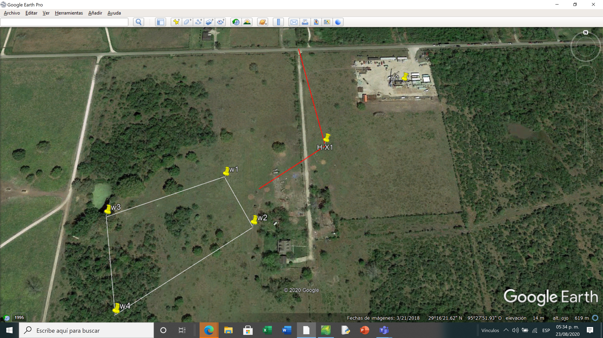
Side track from Harris-2 to Hx1
364´
TD=10500´
water

Slide 2
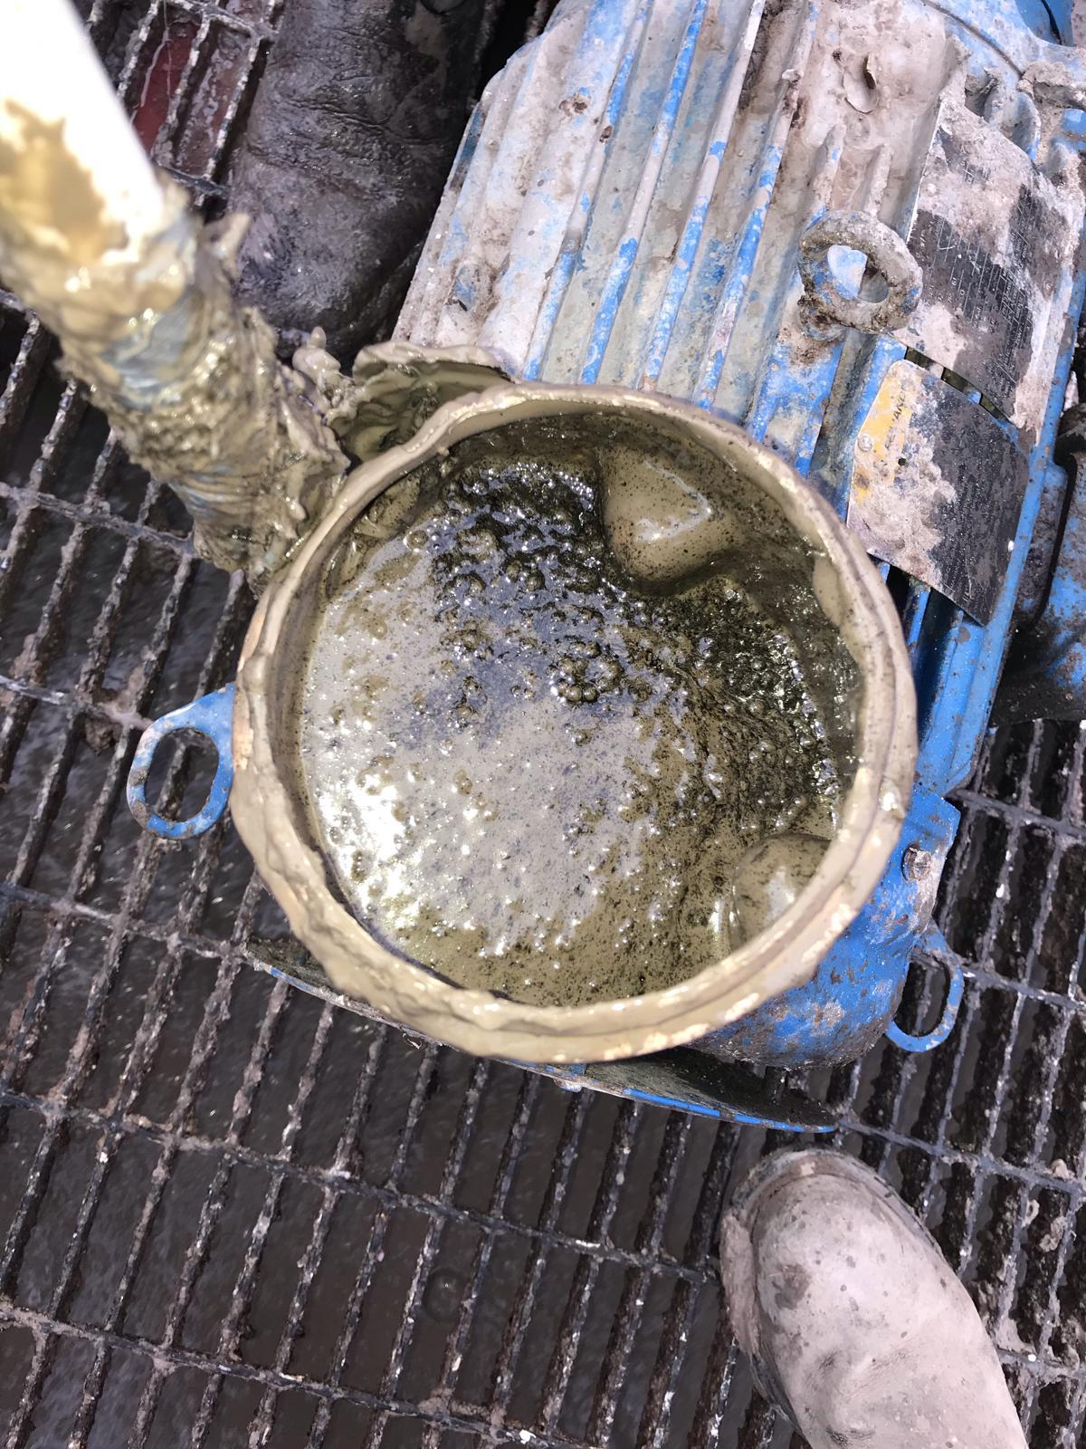
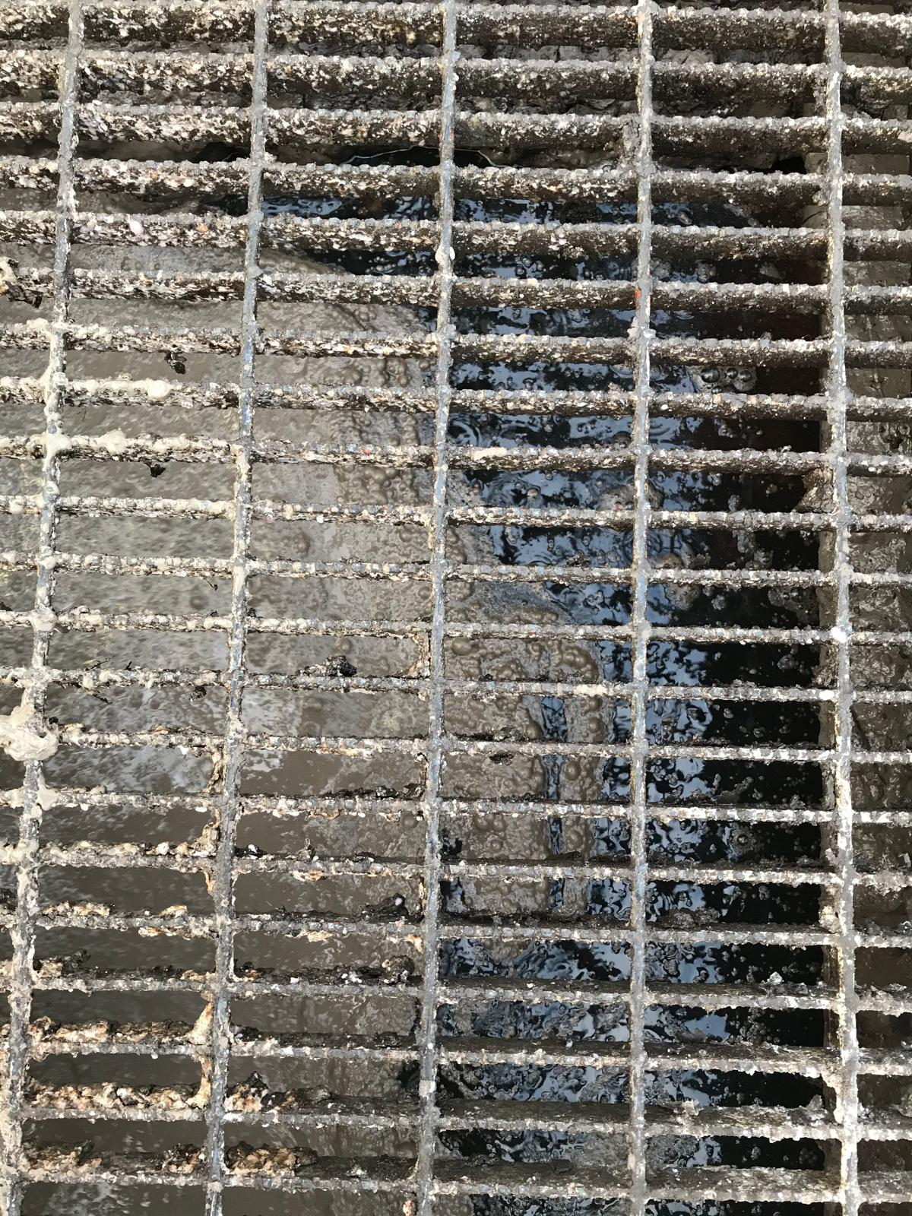
WHEN DRILLING AT 10037-10127´

Slide 3
production of oil in a sand of 100 feet thick

